Slide 1
Retiree Insurance
Faculty and Staff Open Forum Discussions
on Recommended Changes

Slide 2
Guiding principles
Make retiree insurance available to as many employees as possible, especially those with long service or nearing retirement
Maintain pay and benefits for active employees
Offer a pay and benefits package that ensures UM can recruit, retain, and reward talented people
Keep the benefits rate at an affordable percentage for campuses
Improve cost predictability for the overall pay and benefits package

Slide 3
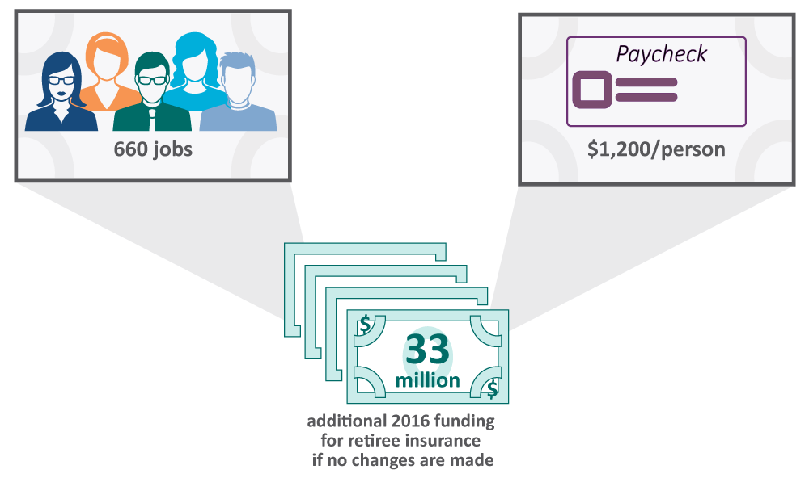
Why changes are needed: Effects if we don’t make a change
UM has an $808 million liability this year, which will only grow over time
Paying this year’s bill on the liability would require an extra $33 million

Slide 4
History and research
Total Rewards Ad-Hoc Task Force (2013 – 2014) | Retiree Medical Study (Jan. – Nov. 2015) | Total Rewards Advisory Comm. (June 2015 – Present)
Recommendation 5: Leverage marketplace opportunities for retiree medical benefits | 30 listening sessions 11 focus groups Survey of over 2,500 employees Comparison with peers Outreach to campus, employee, and retiree leaders, plus comparators Financial analysis: Close scrutiny of many different options; assistance from third-party actuaries | Faculty, staff, and retiree reps. reviewed research, including more than 30 scenarios Many peers: Eliminate retiree insurance Conversely, TRAC’s solution: UM benefits remain available for: All current retirees As many employees as possible

Slide 5
Research: What these changes are not about
Not about the pension plan
The pension plan is well-funded and stable
Not about insurance provided during active employment
Competitive insurance coverages are available to all benefit eligible faculty and staff
Retiree insurance is available to those who become eligible for it

Slide 6
≤4 ← yrs. of service → 25*
 | ≤4 | 5 | 6 | 7 | 8 | 9 | 10 | 11 | 12 | 13 | 14 | 15 | 16 | 17 | 18 | 19 | 20 | 21 | 22 | 23 | 24 | 25*
≤ 25 | D | C | C | C | C | C | C | C | C | C | C | C | C | C | C | C | C | C | C | C | C | C
26 | D | C | C | C | C | C | C | C | C | C | C | C | C | C | C | C | C | C | C | C | C | C
27 | D | C | C | C | C | C | C | C | C | C | C | C | C | C | C | C | C | C | C | C | C | C
28 | D | C | C | C | C | C | C | C | C | C | C | C | C | C | C | C | C | C | C | C | C | C
29 | D | C | C | C | C | C | C | C | C | C | C | C | C | C | C | C | C | C | C | C | C | C
30 | D | C | C | C | C | C | C | C | C | C | C | C | C | C | C | C | C | C | C | C | C | C
31 | D | C | C | C | C | C | C | C | C | C | C | C | C | C | C | C | C | C | C | C | C | C
32 | D | C | C | C | C | C | C | C | C | C | C | C | C | C | C | C | C | C | C | C | C | C
33 | D | C | C | C | C | C | C | C | C | C | C | C | C | C | C | C | C | C | C | C | C | C
34 | D | C | C | C | C | C | C | C | C | C | C | C | C | C | C | C | C | C | C | C | C | C
35 | D | C | C | C | C | C | C | C | C | C | C | C | C | C | C | C | C | C | C | C | C | C
36 | D | C | C | C | C | C | C | C | C | C | C | C | C | C | C | C | C | C | C | C | C | C
37 | D | C | C | C | C | C | C | C | C | C | C | C | C | C | C | C | C | C | C | C | C | C
38 | D | C | C | C | C | C | C | C | C | C | C | C | C | C | C | C | C | C | C | C | C | C
39 | D | C | C | C | C | C | C | C | C | C | C | C | C | C | C | C | C | C | C | C | C | C
40 | D | C | C | C | C | C | C | C | C | C | C | C | C | C | C | C | C | C | C | C | C | C
41 | D | C | C | C | C | C | C | C | C | C | C | C | C | C | C | C | C | C | C | C | C | C
42 | D | C | C | C | C | C | C | C | C | C | C | C | C | C | C | C | C | C | C | C | C | C
43 | D | C | C | C | C | C | C | C | C | C | C | C | C | C | C | C | C | C | C | C | C | C
44 | D | C | C | C | C | C | C | C | C | C | C | C | C | C | C | C | C | C | C | C | C | C
45 | D | C | C | C | C | C | C | C | C | C | C | C | C | C | C | C | C | C | C | C | C | C
46 | D | C | C | C | C | C | C | C | C | C | C | C | C | C | C | C | C | C | C | C | C | C
47 | D | C | C | C | C | C | C | C | C | C | C | C | C | C | C | C | C | C | C | C | C | C
48 | D | C | C | C | C | C | C | C | C | C | C | C | C | C | C | C | C | C | C | C | C | C
49 | D | C | C | C | C | C | C | C | C | C | C | C | C | C | C | C | C | C | C | C | C | C
50 | D | C | C | C | C | C | C | C | C | C | C | C | C | C | C | C | C | C | C | C | C | C
51 | D | C | C | C | C | C | C | C | C | C | C | C | C | C | C | C | C | C | C | C | C | C
52 | D | C | C | C | C | C | C | C | C | C | C | C | C | C | C | C | C | C | C | C | C | C
53 | D | C | C | C | C | C | C | C | C | C | C | C | C | C | C | C | C | C | C | C | C | C
54 | D | C | C | C | C | C | C | C | C | C | C | C | C | C | C | C | C | C | C | C | C | C
55 | D | C | C | C | C | C | C | C | C | C | C | C | C | C | C | C | C | C | C | C | C | B
56 | D | C | C | C | C | C | C | C | C | C | C | C | C | C | C | C | C | C | C | C | B | B
57 | D | C | C | C | C | C | C | C | C | C | C | C | C | C | C | C | C | C | C | B | B | B
58 | D | C | C | C | C | C | C | C | C | C | C | C | C | C | C | C | C | C | B | B | B | B
59 | D | C | C | C | C | C | C | C | C | C | C | C | C | C | C | C | C | B | B | B | B | B
60 | D | C | C | C | C | C | C | C | C | C | C | C | C | C | C | C | A | A | A | A | A | A
61 | D | C | C | C | C | C | C | C | C | C | C | C | C | C | C | B | A | A | A | A | A | A
62 | D | C | C | C | C | C | C | C | C | C | C | C | C | C | B | B | A | A | A | A | A | A
63 | D | C | C | C | C | C | C | C | C | C | C | C | C | B | B | B | A | A | A | A | A | A
64 | D | C | C | C | C | C | C | C | C | C | C | C | B | B | B | B | A | A | A | A | A | A
65 | D | C | C | C | C | C | C | C | C | C | C | B | B | B | B | B | A | A | A | A | A | A
66 | D | C | C | C | C | C | C | C | C | C | B | B | B | B | B | B | A | A | A | A | A | A
67 | D | C | C | C | C | C | C | C | C | B | B | B | B | B | B | B | A | A | A | A | A | A
68 | D | C | C | C | C | C | C | C | B | B | B | B | B | B | B | B | A | A | A | A | A | A
69 | D | C | C | C | C | C | C | B | B | B | B | B | B | B | B | B | A | A | A | A | A | A
≥70 | D | C | C | C | C | C | B | B | B | B | B | B | B | B | B | B | A | A | A | A | A | A
* Employees with ≥ 25 Yrs of Service will fall into categories A, B , or C depending on Age and Yrs of Service
≥ 70 ← age as of 12/31/2017→ ≤ 25
Access Category D:
On 12/31/2017:
Yrs of Service < 5
Access to UM retiree insurance:
Ineligible
Plan closing to employees with less than 5 Years of Service, as well as new hires
Access Category B:
On 12/31/2017:
Age + Yrs of Service ≥ 80
But either Age < 60 or Yrs < 20
Access to UM retiree insurance:
As long as employee works to at least age 60 & 20 yrs. service:
UM coverage
Current % subsidy
Access Category C:
On 12/31/2017:
Age + Yrs of Service < 80
Yrs of Service ≥ 5
Access to UM retiree insurance:
As long as employee works to at least age 60 & 20 yrs. service:
UM coverage
Subsidy is $100/yr. for each Year of Service; $2,500 max. annually
Access Category A:
On 12/31/2017:
Age ≥ 60
Yrs of Service ≥ 20
Access to UM retiree insurance:
UM coverage
Current % subsidy

Slide 7
Recommendations: Access Categories
Access Category A
Age: 60+
Years of Service: 20+
Access Category B
Age + Years of Service = 80 or more, but …
Either not yet Age 60 or not yet 20 Years of Service
Access Category C
Age + Years of Service = less than 80, but …
5 or more Years of Service
Access Category D
Less than 5 Years of Service
Note:
If approved, criteria for a given Access Category must be met before the recommended effective date of 01/01/2018 (e.g., must be Age 60 with 20 Years of Service by 12/31/2017 to be in Access Category A).
!

Slide 8
Recommendations: Changes that would become effective January 1, 2018
Recommended changes to UM retiree insurance coverage
Access Category A: UM coverage; no change to coverage
Access Categories B and C: UM coverage, if you reach Age 60+ and 20+ Years of Service by your retirement date
Access Category D: Ineligible
Recommended changes to UM retiree insurance subsidies
Access Category A: Percentage subsidy, no change to subsidy
Access Category B : Percentage subsidy coverage, if you reach Age 60+ and 20+ Years of Service by your retirement date
Access Category C: $100/Year of Service to purchase UM coverage; maximum of $2,500 annually, if you reach Age 60+ and 20+ Years of Service by your retirement date
Access Category D: Ineligible
Recommended plan closure
Plan closes to Category D (i.e., less than 5 Years of Service) and new hires

Slide 9
Next steps
Open forums: 2/17 at 10:30 – Noon, 3:30 – 5:00 PM
Apr. or June
Board action on final recommendations
BOC action taken
Support tools provided to help faculty/staff learn how changes affect individual retirement plans
More details at http://umurl.us/retireerec
Jan. 1, 2018
If approved, the recommended changes go into effect on this date
Feb. 10 – Mar. 18

Slide 10
What’s your feedback?
?

Slide 11
Next steps: What should I do now?
Attend an open forum
Apr. or June
Once a decision is made by the Board of Curators, you will receive notice of the decision and any next steps
Immediately after
If it is determined that a change will occur, access the support tools provided to learn how the changes affect you
Review the full TRAC Report and other details at http://umurl.us/retireerec
Feb. 10 – Mar. 18
Read the materials sent to your home

Slide 12
For more information
http://umurl.us/retireerec
HR Service Center
(573) 882-2146
(800) 488-5288
retiree-ins@umsystem.edu

